Slide 1
Hot Compliance Topics for Managers and Physician Practices
Summer Southern Conference
MGMA-LA / MGMA-MS
Biloxi, Mississippi
August 11-13, 2021
Clay J. Countryman – Attorney/Partner
Breazeale, Sachse & Wilson, L.L.P.
Baton Rouge, LA
clay.countryman@bswllp.com
225-381-8037

Slide 2
Focus of Presentation
Key requirements of the No Surprises Act for physician practices.
Recent cases by the Department of Justice involving improper referral relationships by physician practices.
Stark Law Changes and Physician Compensation.
The Biden Administration’s directives regarding (physician) non-compete agreements.
Audits and potential liability for use of COVID-19.

Slide 3
No Surprises Act – Proposed Rules
Highlights
Most provisions in the recent proposed rule will not take effect until January 1, 2022.
Bans surprise billing for emergency services.
Bans surprise billing for emergency services, regardless of where they are provided.
Providers are required to bill emergency services on an in-network basis without prior authorization.

Slide 4
No Surprises Act – Proposed Rules
Bans high out-of-network cost-sharing for emergency and nonemergency services.
CMS proposed that cost-sharing can’t be higher than if the services were provided by an in-network physician.
Bans surprise billing for ancillary services and any “others”.
Prohibits out-of-network charges for ancillary care in in-network facilities in all instances.
Interim payment or notice of denial from insurers.
Requires health plans to make an initial payment or issue a notice of denial to providers within 30 days of a clean claim.

Slide 5
No Surprises Act – Proposed Rules
Consent process to waive balance-billing protections.
Allows patients to waive their balance-billing protections and consent to out-of-network charges.
Providers can’t use this for emergency services some ancillary services.
Providers must disclose balance-billing protections.
Providers will be required to post publicly to inform patients about their surprise-billing protections.

Slide 6
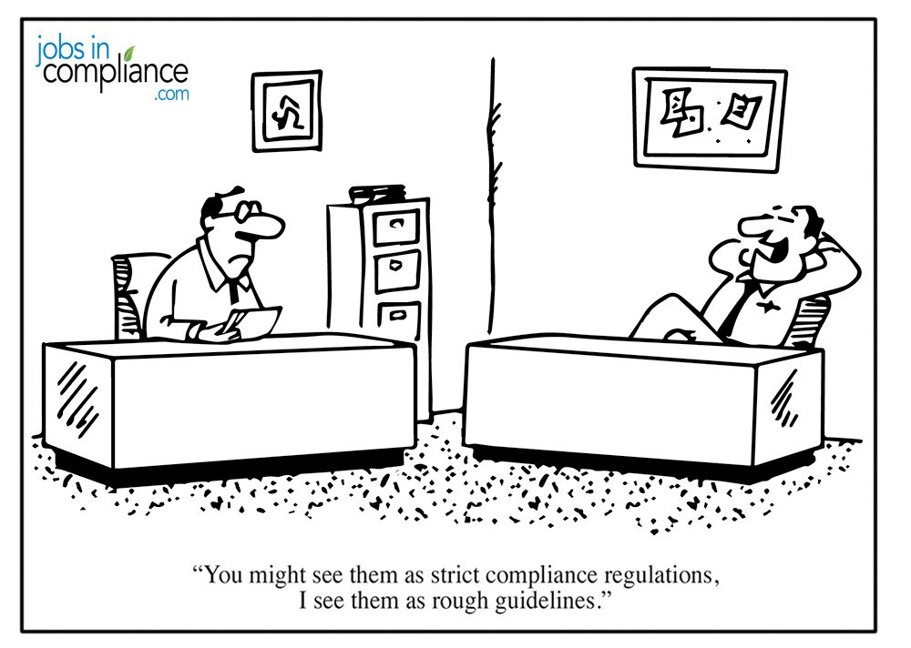
Compliance and the DOJ

Slide 7
No Surprises Act – Proposed Rules
Qualifying payment amount.
CMS defined the qualifying payment amount, which will calculate patient cost-sharing and be used by an arbiter in the independent dispute resolution process, as the issuer’s median in-network rate for 2019 trended forward.
Complaint process.
CMS will establish a process for which patient and others can submit complaints about violations of the balance-billing requirements.
Arbitration process.
The first interim rule doesn’t discuss the dispute resolution process.

Slide 8
Recent DOJ Fraud Cases Involving Illegal Payments to Physicians for Referrals
Prime Healthcare Services and Two Doctors Paid $37.5 million to settle False Claims Act allegations
The settlement resolves allegations that:
Prime paid kickbacks by paying a purchase price for Dr. Arunasalam’s physician practice and surgery center that exceeded fair market value and was not commercially reasonable.
Prime also knowingly overcompensated Dr. Arunasalam in an employment agreement that was based on the volume and value of his patient referrals;
A vascular provider owned by Prime used Dr. Arunasalam’s billing number to bill Medicare for services that were provided by another physician; and
Prime hospitals billed Medi-Cal, the Federal Employees Health Benefits Program and the U.S. Department of Labor’s Office of Workers’ Compensation Programs for false claims based on inflated invoices for implantable medical hardware.

Slide 9
Recent DOJ Fraud Cases Involving Illegal Payments to Physicians for Referrals
Advanced Pain Management in Greenfield, WI
Paid $885,452 to settle False Claims Act violations based on “improperly gifting shares of incentive stock” to non-employee physicians who performed pain management procedures at its ASCs.
Government also alleged that illegal remuneration was paid for “medical director” services that were not supported by written agreements and services were not recorded.

Slide 10
Recent DOJ Fraud Cases Involving Illegal Payments to Physicians for Referrals
Maryland Cardiologist Pays $750,000 for Alleged Kickbacks (April, 2020)
Resolves allegations that a Maryland cardiologist induced patient referrals by providing ankle-brachial index testing on patients under agreements with the referring physicians but without collecting from the physicians the fair market value for the tests.
Ankle-brachial index testing is used to detect peripheral arterial disease, which this Maryland cardiologist and his affiliated practices would treat.
Case was a whistleblower suit brought by a former sales and operations employee of the cardiologist and his practices.

Slide 11
Recent DOJ Fraud Cases Involving Illegal Payments to Physicians for Referrals
Wilson Asfora, M.D., Medical Designs LLC and Sicage LLC
Paid $4.4 million to resolve False Claims Act allegations relating to illegal payments to Dr. Asfora to induce the use of certain medical devices in which he had a financial interest in violation of the Anti-Kickback Statute.
Government alleged 3 Kickback Schemes:
Medical Designs and Sicage paid Dr. Asfora profit distributions in exchange for Dr. Asfora using Medical Designs’ and Sicage’s devices in his spine surgeries;
Medical Designs acted as a distributor, reselling other manufacturers’ spinal devices and splitting profits with Dr. Asfora when he used those devices in surgeries; and
Dr. Asfora solicited and received kickbacks from medical device manufacturer Medtronic USA Inc. in exchange for using its infusion pumps.

Slide 12
Recent DOJ Fraud Cases Involving Illegal Payments to Physicians for Referrals
Advanced Pain Management in Greenfield, WI
Paid $885,452 to settle False Claims Act violations based on “improperly gifting shares of incentive stock” to non-employee physicians who performed pain management procedures at its ASCs.
Government also alleged that illegal remuneration was paid for “medical director” services that were not supported by written agreements and services were not recorded.

Slide 13
COVID-19 Provider Relief Funds
HHS disbursed the Provider Relief Funds through both “general” and “targeted” distribution payments, and allocated the funding to one of 3 Phases:
Phase 1 included $50 billion for Medicare providers.
Phase 2 provided $18 billion for Medicaid, CHIP, dental and certain other Medicare providers, as well as assisted living facilities.
Phase 3 provided $24 billion for certain behavioral health providers, newly practicing providers and providers that received a payment under a previous phase.

Slide 15
CARES ACT & PPP
Government grants
CARES ACT must use funds to prevent, prepare for, and respond to coronavirus
PPP hybrid loan/grant (portion of loan is converted to grant if used for employee wages)
CARES Act was automatically given to qualifying healthcare providers
PPP—loan application process
Both CARES Act and PPP loans had 30-day opt out period

Slide 16
HHS May 2021 Report – Audits on Use of COVID-19 Provider Relief Funds
The May 2021 HHS report indicates forecasts post-COVID regulatory crackdowns and scrutiny going forward.
These upcoming audits will review both revenue information and supporting documentation submitted to HRSA as a part of determining PRF eligibility and payment amounts.
The audits will focus on whether payments were:
correctly calculated for providers that applied for these payments;
supported by appropriate and reasonable documentation; and
made to eligible providers.

Slide 17
Biden Administration and Non-Compete Agreements
On July 9, 2021, President Biden issued an Executive Order on Promoting Competition in the American Economy, that included a focus on healthcare mergers and restricting non-competition agreements.
With respect to restricting the use of non-compete agreements, Section 5(g) of the Executive Order asks the Federal Trade Commission (FTC) to use its regulatory authority “curtail the unfair use of non-compete clauses and other clauses or agreements that may unfairly limit worker mobility.”
Many states since July 9th have starting proposing legislation to prohibit or severely limit non-compete clauses.

Slide 18
Recent Texas Physician Non-Compete Case
The Texas Fourteenth District Court of Appeals recently reversed a $9 million judgment won by an orthopedic spine surgeon, Dr. Richard Francis, against a Texas ambulatory surgical center – the Houston Metro Ortho and Spine Surgery Center (Metro ASC).
In 2014, “two large insurance companies stopped paying Metro for services rendered to their insureds.” Consequently, Dr. Francis began performing procedures at other facilities. That same year, the Metro ASC board of directors voted to remove Dr. Francis as a member/owner.
Dr. Francis had began performing more procedures at other facilities despite an agreement between surgeons at Metro ASC to perform a certain number of procedures at the ASC.
In 2015, Metro ASC sued Dr. Francis alleging that he had violated his noncompete agreement.
Dr. Francis countersued the Metro ASC arguing that he was owed for his ownership interest and for missed distributions of earnings.

Slide 19
Questions?
Thank You!

